Slide 1

Fix it yourself
detecting and fixing UEFI firmware vulnerabilities without access to it’s source code
Nikolaj Schlej
Software Engineer BIOS, congatec AG
schlej@live.de, @NikolajSchlej
26.11.2015

Slide 2


About me
0
a.k.a. CodeRush
tinkering with UEFI since 2011
came to InfoSec from BIOS modding community
author of UEFITool
wrote master thesis on CoMs UEFI security
work for congatec AG as BIOS engineer

Slide 3

Agenda
1
Brief Intro to (U)EFI
What an Attacker Can Do?
Attack Vectors
Protections
An Average System
Test Tools
Test Results
What Now?
Prepare to Dig Deep
Fix It Yourself
Conclusion
Q&A

Slide 4

Brief Intro to (U)EFI
2

Slide 5

Brief Intro to (U)EFI: What is it?
3
(Unified) Extensible Firmware Interface
modern industrial standard for x86 firmware
initially developed by Intel as BIOS replacement for IA64
used by Macs since 2007, PCs since 2009
performs HW initialization required to start an OS
modular and feature rich, uses well defined and known formats
mostly written in C, much easier to develop as legacy BIOS

Slide 6
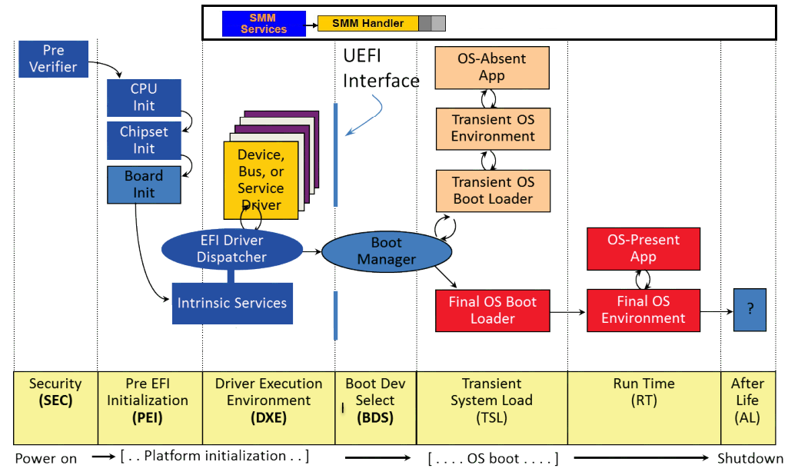
Brief Intro to (U)EFI: Boot flow
4

Slide 7
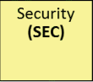
Brief Intro to (U)EFI: SEC concepts
5
purpose: initialize enough HW to run code that uses stack
wrote in assembler, microarchitecture dependent
provided by CPU vendor
despite of it’s name, makes no security checks by default
switches BSP to 32 bit mode with flat memory
detects and initializes CPU caches
sets L2 cache to no-eviction mode¹, so it can be used as preliminary RAM
finds PEI Core and transfers control to it
[1] a.k.a. Cache-as-RAM, more info here: coreboot.org/images/6/6c/LBCar.pdf

Slide 8
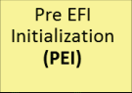
Brief Intro to (U)EFI: PEI concepts
6
purpose: initialize RAM and mission-critical hardware
has two sub-phases: BeforeMem and AfterMem
binaries stored in PE32 and TE² formats
BeforeMem binaries must be executable in place
PEI Core and Modules
PEI dependency expressions
PEI-to-PEI Interfaces and Hand-Off Blocks
PeiServices
on S3 resume, UEFI boot process ends here
otherwise, control and HOBs are transferred to DXE Core
[2] Terse Executable, a PE32 with most of it’s headers cut off to save precious space in L2 cache

Slide 9
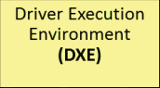
Brief Intro to (U)EFI: DXE concepts
7
purpose: initialize all remaining hardware
64 bit code on most machines, exceptions are rare
binaries stored in PE32+ format
DXE Core, Dispatcher, Drivers, OROMs and Applications
DXE Protocols
SMM Core, Dispatcher, Drivers and SMI Handlers
DXE dependency expressions
BootServices and RuntimeServices
dispatches all available drivers and starts BDS application

Slide 10
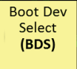
Brief Intro to (U)EFI: BDS concepts
8
purpose: find a bootloader and transfer control to it
POST screen, BIOS Setup, firmware update, recovery tools, etc.
all UEFI stuff including BootServices, loaded drivers, published protocols and so on, is available to UEFI bootloaders
final OS bootloader should generate ExitBS event
after that, only runtime services, ACPI tables, SMI handlers and special purpose memory regions are accessible to OS, all other memory is marked free

Slide 11

What an Attacker Can Do?
9

Slide 12

What an Attacker Can Do: PWNAGE
10
persist across OS reinstall and hard drive change
obtain full access to hardware, physical memory and CPU context
steal secrets from OS and sent them out by network
resist detection to a point of being virtually undetectable without additional hardware
in other words: PWN EVERYTHING

Slide 13

What an Attacker Can Do: A quote
11
[3] “How Many Million BIOSes Would You Like to Infect” by Corey Kallenberg and Xeno Kovah

Slide 14
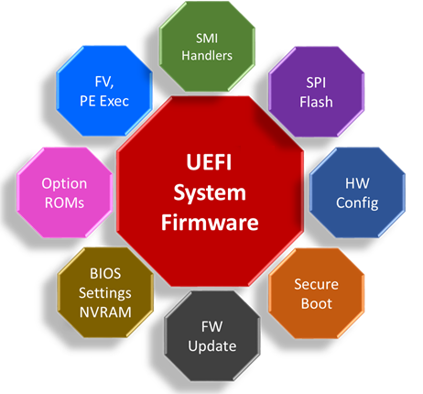
Attack Vectors
12
[4] “UEFI, Open Platforms, and the Defender’s Dilemma” by Vincent Zimmer

Slide 15
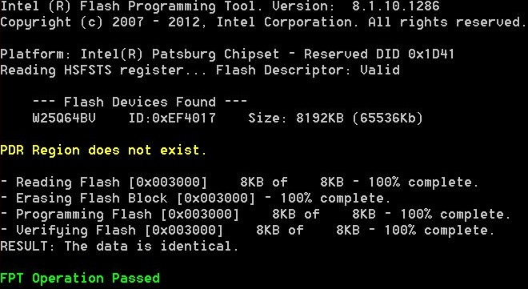
Attack Vectors: SPI flash chip
13
the most desired and dangerous attack vector
successful attack leads to full system control if verified boot isn’t used, DoS otherwise
provides persistence, renders all other protections futile
there are millions of systems without any SPI flash protection, waiting to be pwned

Slide 16

Attack Vectors: SMI handlers
14
one of the most privileged execution modes available
successful attack very often provides SPI flash access
tons of systems are (still) vulnerable
hard to fix even with source code, almost impossible without one
can’t be disabled without major rework of the whole firmware
[3] “How Many Million BIOSes Would You Like to Infect” by Corey Kallenberg and Xeno Kovah

Slide 17

Attack Vectors: S3 BootScript
15
set of instructions to restore system configuration on ACPI S3 resume, gathered in DXE phase
enables fast resume, when the whole DXE phase is skipped
was stored in ACPI NVS memory available for OS-level attacker
now copied to SMRAM, a successful attack on SMM renders SMM-based BootScript protection useless
SPI flash protections can be disabled after a vulnerable S3 cycle
most systems are vulnerable even after a year from disclosure

Slide 18
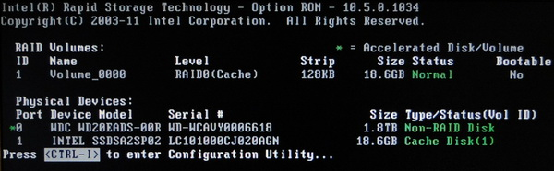
Attack Vectors: Option ROMs
16
stored on internal PCI(e) devices
and any external devices capable of PCI bus mastering: Firewire, Thunderbolt, ExpressCard, etc.
loaded during DXE phase as normal DXE drivers
no verification performed if SecureBoot is disabled
some systems will launch an Option ROM even if verification fails
attacker can modify an Option ROM of an existing device

Slide 19
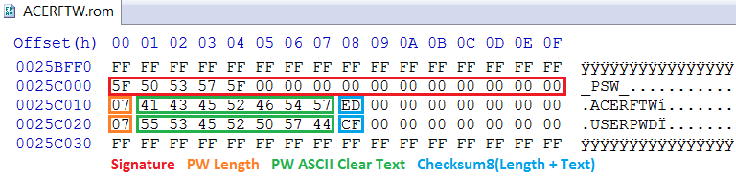
Attack Vectors: BIOS Setup
17
can control SPI flash access
controls SecureBoot
settings are stored in NVRAM variable called “Setup”, which can be changed from UEFI Shell (always) or any UEFI-bootable OS (if the variable has RT flag)
protected by password, which can be stored using a weak algorithm, removed with “factory password” or reset by PC vendor

Slide 20
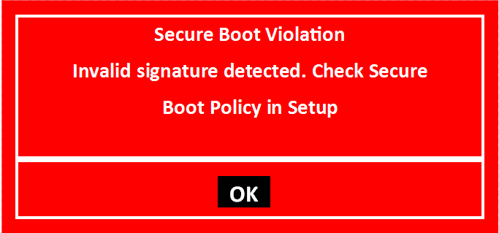
Attack Vectors: SecureBoot
18
controlled from BIOS Setup
default mode trusts too many parties: PC vendor, Microsoft, anyone who get an image signed by Microsoft ($99 only), Canonical, may be more.
erasing PK variable disables SecureBoot completely
various known vulnerabilities can still be present

Slide 21
Attack Vectors: Vendor-specific
19
engineering backdoors may exist in different parts of the system: 0. factory password for BIOS Setup 1. vendor’s SMM-based BIOS flasher used for SMBIOS information editing 2. special signature or hash in DB to bypass SecureBoot 3. anything that can help restore a locked or unbootable configuration without RMA
vulnerabilities may (sure) exist in vendor flash tools, SMI handlers, SecureBoot implementations, etc.
there are almost no public researches for vendor-specific vulnerabilities, mostly because of NDAs

Slide 22

Protections
20

Slide 23
Protections: SPI flash
21
read-only flash is the best, but almost impossible because of ME and NVRAM
Intel Flash Descriptor restricts access to regions other than BIOS
hardware-validated boot (Intel BootGuard, AMD PSP) converts evil SPI reflash from total PWNAGE to an ordinary DoS
BiosGuard (PFAT) disables SPI reflash from SMM code
Protected Range Registers can be used to restrict read/write access to certain flash regions, even for SMM code
SMM_BWP bit disables SPI reflash from normal OS code
BLE/BIOS_WE considered broken⁵ and shouldn’t be used anymore
[5] “Attacks on UEFI security, inspired by Darth Venamis's misery and Speed Racer” by Korey Kallenberg and Rafal Wojtczuk

Slide 24
Protections: SMI handlers
22
the best protection is to disable SMM for good, if possible
TSEGMB register protects SMM code and data from DMA attacks
Intel SMI Transaction Monitor can be used to protect the system from evil SMM code
Intel Software Guard Extension can be used to protect an application from all evil code, including SMM
MSR_SMM_FEATURE_CONTROL can be used to protect from SMM call-outs
Phoenix NX trick⁶ can also be used to protect from SMM call-outs even on AMD and older-than-Haswell Intel systems
Defensive coding and multistage code review are very helpful
[6] “UEFI Firmware – Securing SMM” by Dick Wilkins

Slide 25

Protections: S3 BootScript
23
the best protection is to disable S3 for good
BootScript can be stored inside security coprocessor (AMD PSP)
SmmLockBox can be used to store a copy of the BootScript in SMRAM to verify that the original is not changed
hardware-reduced platforms and embedded systems can use a static BootScript-less S3 resume boot path

Slide 26
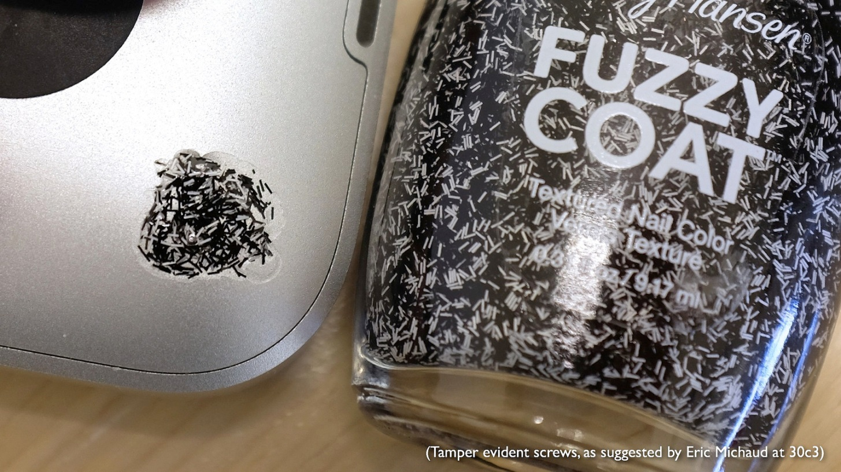
Protections: Option ROMs
24
disable any external interfaces with PCI bus mastering
enable, setup and use SecureBoot, set it’s policy to prevent launch of unsigned Option ROMs
prevent unnoticed hardware changes

Slide 27
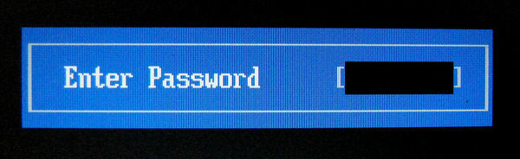
Protections: BIOS settings
25
the best protection is to remove NV from NVRAM, a.k.a. NVRAM emulation
use BIOS password to prevent easy access to BIOS Setup
use SecureBoot to prevent loading of UEFI Shell, which can access all non-auth variables including “Setup” and “Defaults”
review the code of your bootloader, as it have the same access level as UEFI Shell until ExitBS event is generated

Slide 28

Protections: Vendor-specific and 0-days
26
the best protection from that stuff is a good old paranoia
second best are KISS principle and common sense
if the system can boot your favorite OS without any given component, remove it to reduce possible attack surface
remove all vendor-specific flash tools, recovery tools, password restoration tools, etc.
use a minimal trusted bootloader, write one if you don’t trust shim

Slide 29

An Average System
27

Slide 30
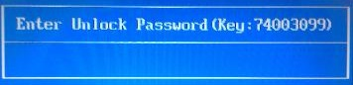
An Average System: Acer R3-471T
28
entry-level laptop produced by Acer
based on Haswell ULT SoC, Core i3-4030U in my case
uses Quanta ZQX motherboard with 4Gb DDR3L memory and optional dedicated graphic card onboard
firmware based on Insyde H₂O platform, UEFI 2.3.1C compatible
latest firmware version is v1.09, published in July 2015
supports SecureBoot, BIOS Setup password protection, BIOS Setup unlock via Acer Support

Slide 31

Test Tools
29

Slide 32
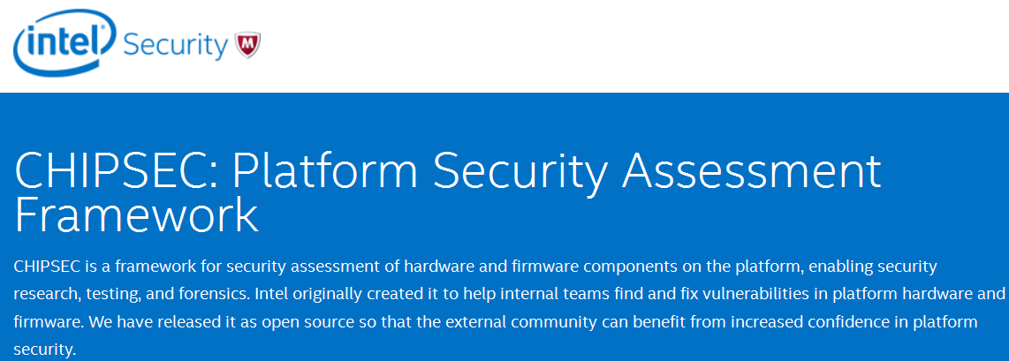
Test Tools: CHIPSEC
30
platform security assessment framework by Intel ATR
has two versions, open source and proprietary
open source version is available on github.com/chipsec/chipsec
proprietary version is available for systems vendors and has diagnostics for yet undisclosed vulnerabilities
can be started from Linux and UEFI Shell
detects various misconfigurations and vulnerabilities specific to the Intel platform it runs on

Slide 33
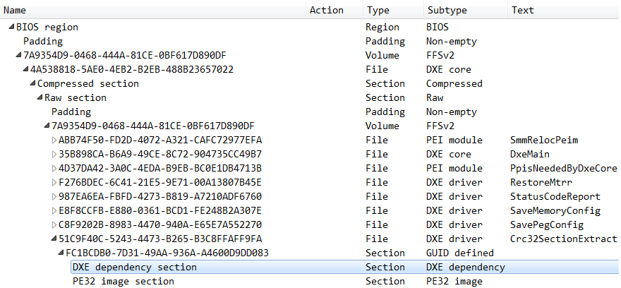
Test Tools: UEFITool
31
open source tool to decompose, view and modify UEFI firmware images
parses firmware image file into a tree structure, detects some misconfigurations
reconstructs an image with all modifications done

Slide 34
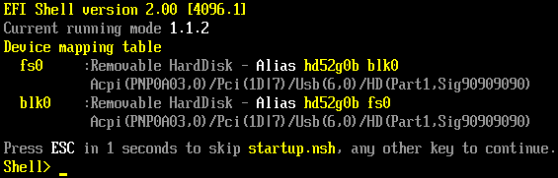
Test Tools: UEFI Shell
32
loaded as transient UEFI booloader
provides console with access to UEFI state after BDS phase end
has various useful command to view and change physical memory, load and unload DXE drivers, change NVRAM variables and so on
can run UEFI applications under itself
acts as modern DOS replacement, single user CUI OS with direct memory and hardware access
useful for UEFI debugging, extremely dangerous in wrong hands

Slide 35

Test Results
33

Slide 36

Test Results: CHIPSEC
34
PR registers set to WP the whole BIOS except NVRAM OK
PR registers are reset to zero after S3 FAIL
S3 BootScript is located outside SMRAM, not protected from any changes, has numerous DISPATCH opcodes FAIL
SMM_BWP is not set, NVRAM region is protected only by BLE/BIOS_WE FAIL
“Setup” variable has RT flag FAIL

Slide 37

Test Results: UEFITool
35
BIOS has Capsule flash services, Insyde IHISI flash interface, Intel PFAT flash driver, SecureFlash driver MISTRUST
has WPBT⁷ driver, the firmware can automatically install and run Windows executables MISTRUST
has UnlockPwd driver, the attacker can override BIOS Setup password with Acer’s tech support help MISTRUST
BIOS Setup password is stored as cleat text FAIL
[7] http://download.microsoft.com/download/8/a/2/8a2fb72d-9b96-4e2d-a559-4a27cf905a80/windows-platform-binary-table.docx

Slide 38

Test Results: UEFI Shell
36
UEFI network stack is loaded and operational regardless of PXE and/or boot settings MISTRUST
SPI flash protection and SecureBoot can both be disabled by changing “Setup” variable FAIL

Slide 39

What Now?
37

Slide 40

What Now: Answers
38
emulate NVRAM to get rid of any flash writes after POST
make the whole BIOS region read-only
protect BIOS password storage from reading
disable S3 and remove it’s support for good
setup, test and use SecureBoot
remove WPBT driver, UnlockPwd driver, BIOS protection drivers, flash drivers, recovery drivers, UEFI network stack and other unneeded and potentially vulnerable components
prepare a golden BIOS image and periodically check against it

Slide 41

Prepare to Dig Deep
39

Slide 42
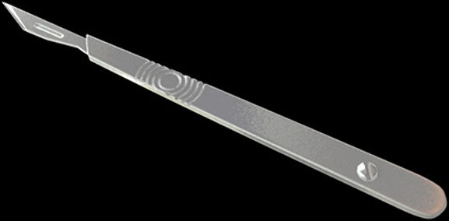
Prepare to Dig Deep: Hardware
40
field surgery on UEFI images will be painful
it will crash, it will brick, it will go nuts, but you can try again until ether it is done or you are done
some things can be done to ease the pain, such as: 0. disassemble the laptop to the bare board and remove all you can remove from it 1. find or buy board schematics 2. buy (and modify, if needed) mPCIe LPC POST card 3. get a decent SPI programmer and replace onboard SPI chip with ZIF socket, or use a SPI emulator instead

Slide 43
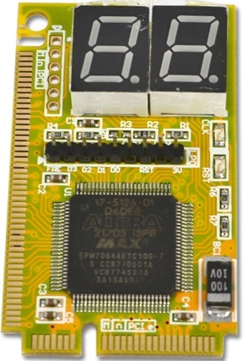
Prepare to Dig Deep: POST card
41
most laptops still use SuperIO controllers on LPC bus
debug port 80h is decoded to LPC bus by default
Sintech makes cheap LPC debug cards, ideal for our purposes
there is no standard LPC debug port pinout, so your system may use a different one
two possible solutions: either find a compatible card or make one compatible

Slide 44
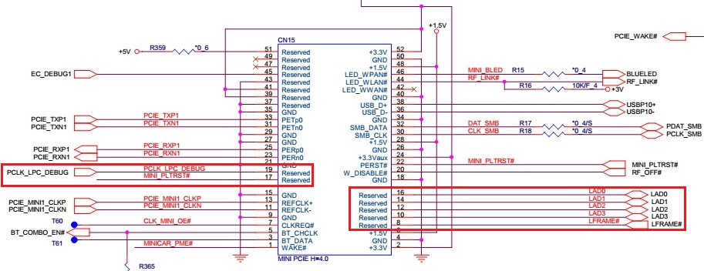
Prepare to Dig Deep: ST8672 card pinout
42
Sintech ST8672 is an LPC debug card with mPCIe interface
costs about $5, easy to modify because of single-layer PCB
LPC signals are on pins 8 (LAD0), 10, 12, 14 and 16 (LFRAME#)
LPC clock is on pin 19, platform reset signal is on pin 17
this is the most popular pinout with the cheapest cards available

Slide 45
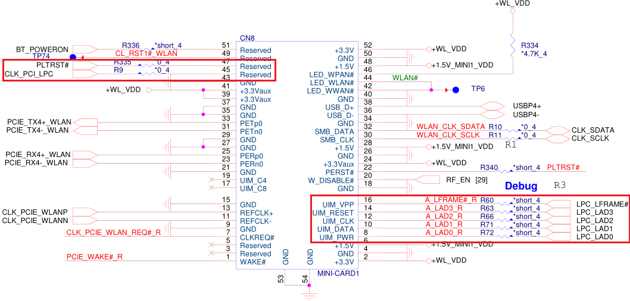
Prepare to Dig Deep: Quanta ZQX pinout
43
Quanta uses a different pinout for it’s newer boards
LPC signals are still on pins 8, 10, 12, 14 and 16, but reversed
LPC clock is on pin 45 (instead of 19), platform reset signal is on pin 47 (instead of 17), some resistors must be added

Slide 46
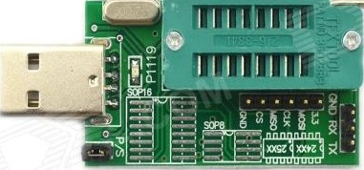
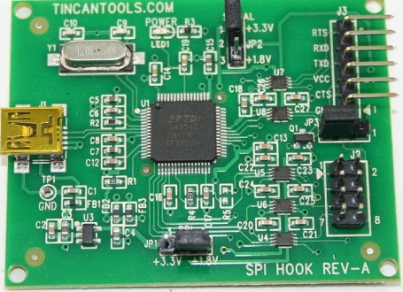
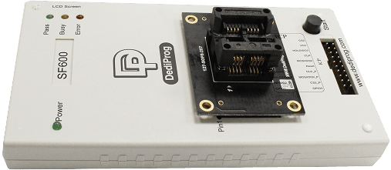
Prepare to Dig Deep: SPI programmer
44
cheapest SPI programmers (down to $3) are based on WCH CH341A USB-serial converter, but they totally worth the price
FTDI FT2232H-based programmers are relatively cheap (around $20) and able to flash all current SPI chips using flashrom⁸
even better options are Autoelectric TL866A and Dediprog SF600, but beware the price
use voltage level shifter to interface with 1.8V SPI flash chips, if your programmer doesn’t support them natively
[8] http://flashrom.org/Flashrom

Slide 47
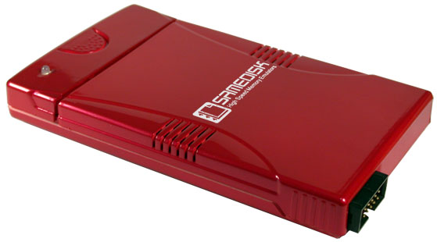
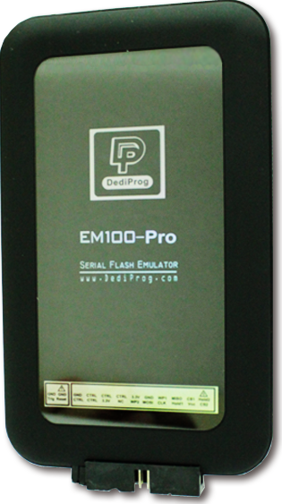
Prepare to Dig Deep: SPI emulator
45
replaces physical SPI flash chip with virtual one
100x speed-up of flash update, image editing on-the-fly
the only downside compared to SPI programmer is price, which starts on $300 and goes up very fast
tried Samedisk ZC25128 and Dediprog EM100-Pro, 10/10 will use again

Slide 48

Prepare to Dig Deep: Software
46
Linux with python2 for using Chipsec, openssl and efitools for setting up SecureBoot and signing your bootloader
TianoCore EDK2 build environment to build your PEI/DXE drivers
UEFI Shell binary that works on your platform
UEFITool or any other similar tool to modify UEFI images
good disassembler like radare2 or IDA
Intel ASL compiler for possible DSDT reverse and modification
your favorite hex editor
anything else you will find useful

Slide 49

Fix It Yourself
47

Slide 50
Fix It Yourself: NVRAM emulation
48
NVRAM is accessible using four UEFI runtime services: GetVariable, SetVariable, GetNextVariableName, QueryVariableInfo
we need to hook this services after they are published and after all reads and writes initiated by the firmware are done
possible hook points are on EndOfDxe, ReadyToBoot and ExitBS
EndOfDxe hook will render BIOS Setup useless – too early
ReadyToBoot hook will require auth. variable emulation for SecureBoot – too hard to implement properly
ExitBS hook is the latest point possible, and a bootloader will have full access to the firmware – SecureBoot and trusted bootloader are mission-critical

Slide 51
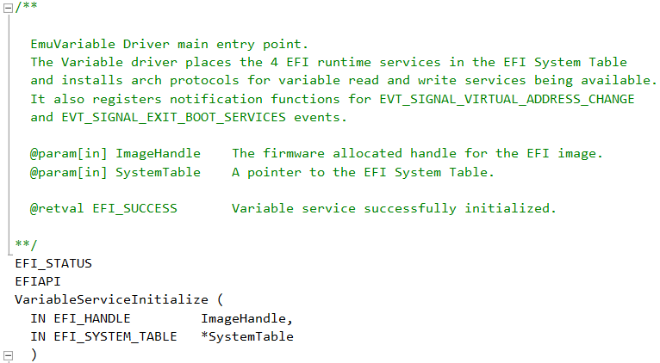
Fix It Yourself: EmuVariable driver
49
TianoCore has a reference NVRAM emulation driver in MdePkg
Clover Bootloader has an expanded one⁹ for starting OSX on PC
changed the driver from Clover to start emulation on ExitBS
[9] http://sourceforge.net/p/cloverefiboot/code/HEAD/tree/EmuVariableUefi/

Slide 52
Fix It Yourself: Problems with FLOCKDN
50
PR registers should be set to write-protect the real NVRAM region
which means it must also be done on ExitBS
but we can’t change their values after FLOCKDN bit is set
it’s done by PchInitDxe driver on this platform
the driver must be patched to prevent locking the flash configuration in DXE phase, but we absolutely must lock it in our driver afterwards

Slide 53
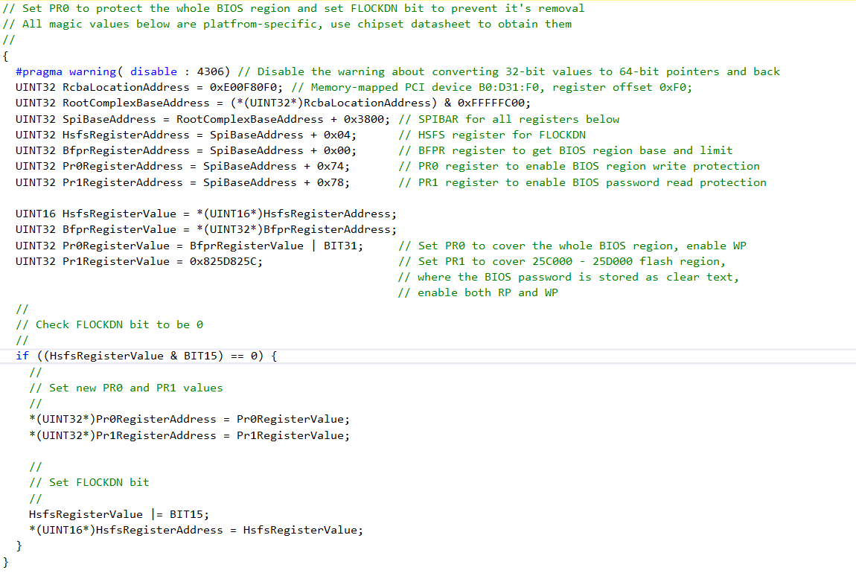
Fix It Yourself: Set PR registers
51

Slide 54
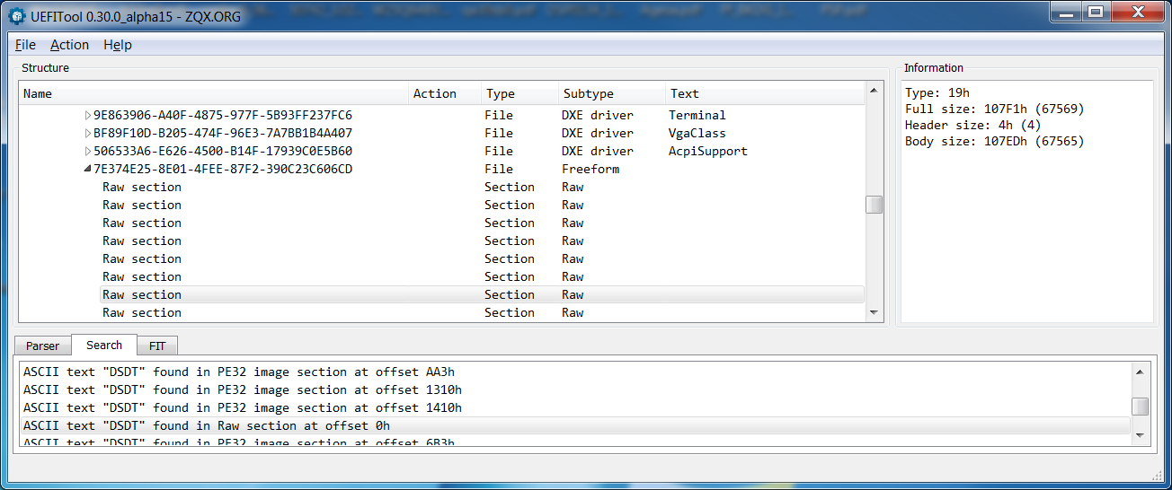
Fix It Yourself: Find DSDT
52
ACPI S3 state availability is reported to OS via DSDT table
DSDT must patched to always report S3 as disabled
but it can also be controlled by BIOS Setup
on this platform, DSDT is stored in a RAW section together with other ACPI tables

Slide 55
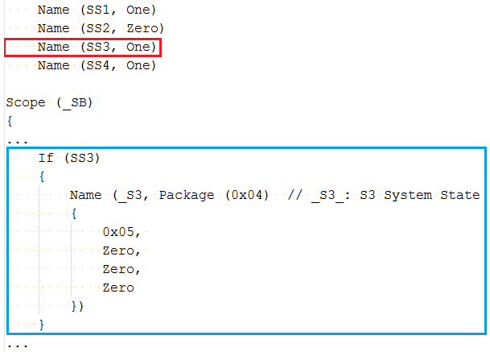
Fix It Yourself: Decompile DSDT
53
ACPI tables are stored in ACPI Machine Language format, but they can be decompiled into human-readable ACPI Source Language using Intel iASL Compiler¹⁰
[10] https://www.acpica.org/downloads

Slide 56
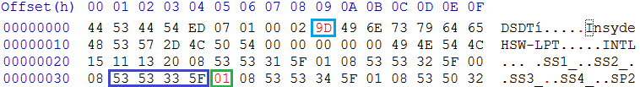
Fix It Yourself: Patch DSDT
54
you can try to edit and recompile DSDT, but it can be tricky to get rid of errors
it’s much easier to patch the default value of SS3 variable from 1 to 0 and fix DSDT checksum
decompile the patched file again, iASL tells what the valid checksum should be

Slide 57
Fix It Yourself: Patch S3 setup handler
55
DSDT patch alone may not be enough, because SS3 variable can be changed from it’s default during DXE phase
find and patch the handler that changes this variable…
…or just replace dangerous SS3 with harmless SS1 in it
you can patch it differently, but the goal is to disable S3 for OS

Slide 58
Fix It Yourself: Final stone on S3 grave
56
now we need to make sure that S3 boot path will never work, so even if the attacker manages to prepare the whole new DSDT with enabled S3, it will only result in hard reset or crash
it can be done by patching PeiGetBootMode to never return BOOT_ON_S3_RESUME
or by destroying S3 BootScript on ExitBS
or by writing a simple PEI driver that will call PeiResetService if PeiGetBootMode tells we are in S3 resume
either way is fine

Slide 59
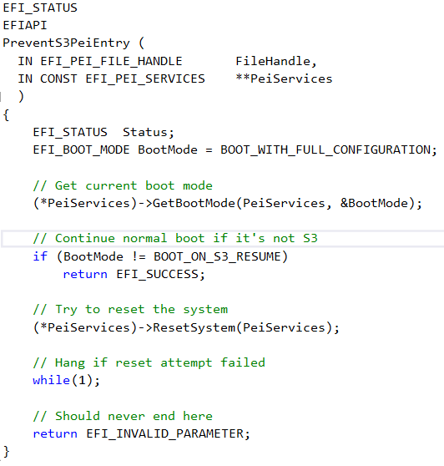
Fix It Yourself: PreventS3Pei driver
57

Slide 60
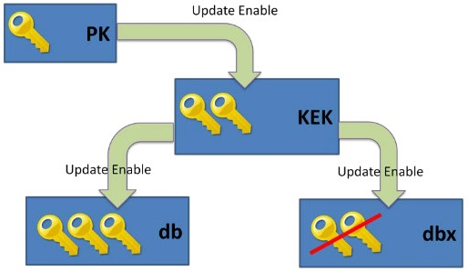

Fix It Yourself: SecureBoot key pairs
58
now we have our SPI flash read-only after ExitBS
but still accessible from UEFI Shell and bootloaders
SecureBoot is to the rescue in this case
to use SecureBoot properly, we need three different key pairs: 1. Platform Key to enable SecureBoot and sign KEK 2. Key Exchange Key to sign db and dbx 3. Image Signing Key to sign bootloaders and executables
all this keys can be generated by using OpenSSL

Slide 61
Fix It Yourself: Generate PK
59
PK key pair suitable for SecureBoot can be generated by the following openssl call: openssl req -new -x509 -newkey rsa:2048 -subj "/CN=Platform Key/" -keyout PK.key -out PK.crt -days 3650 -nodes -sha256
cert-to-efi-sig-list utility from efitools package converts generated certificate to EFI Signature List format: cert-to-efi-sig-list -g "$(uuidgen)" PK.crt PK.esl
PK.esl must be self signed using sign-efi-sig-list utility: sign-efi-sig-list -k PK.key -c PK.crt PK PK.esl PK.auth

Slide 62
Fix It Yourself: Generate KEK
60
KEK key pair can be generated by a similar openssl call: openssl req -new -x509 -newkey rsa:2048 -subj "/CN=Key Exchange Key/" -keyout KEK.key -out KEK.crt -days 3650 -nodes -sha256
use cert-to-efi-sig-list to convert KEK.crt into KEK.esl: cert-to-efi-sig-list -g "$(uuidgen)" KEK.crt KEK.esl
to add multiple certificates into KEK, concatenate their ESL files: cat KEK.esl MsKek.esl > KEK.esl
combined KEK.esl must be signed by PK using sign-efi-sig-list: sign-efi-sig-list -k PK.key -c PK.crt KEK KEK.esl KEK.auth

Slide 63
Fix It Yourself: Generate db
61
db key pair can also be generated by a similar openssl call: openssl req -new -x509 -newkey rsa:2048 -subj "/CN=Image Signing Key/" -keyout db.key -out db.crt -days 3650 -nodes -sha256
use cert-to-efi-sig-list to convert db.crt into db.esl: cert-to-efi-sig-list -g "$(uuidgen)" db.crt db.esl
to add multiple certificates into db, concatenate their ESL files: cat db.esl MsWin.esl UefiCa.esl > db.esl
combined db.esl must be signed by KEK using sign-efi-sig-list: sign-efi-sig-list -k KEK.key -c KEK.crt db db.esl db.auth

Slide 64
Fix It Yourself: Sign your bootloader
62
sign an UEFI Shell binary by db key using sbsign utility: sbsign --key db.key --cert db.crt --output bootx64.efi shellx64.efi
prepare a FAT32-formatted USB flash drive with this signed UEFI Shell in /EFI/Boot, copy UpdateVars.efi from /usr/share/efitools/efi onto it: cp bootx64.efi /media/UsbFlash/EFI/Boot/ cp /usr/share/efitools/efi/UpdateVars.efi /media/UsbFlash/
also copy all *.auth files you’ve prepared on previous steps: cp *.auth /media/UsbFlash/

Slide 65
Fix It Yourself: Enable SecureBoot
63
go to BIOS Setup and set a good supervisor password
insert the prepared USB flash drive and try to boot from it with SecureBoot disabled, it should boot to UEFI Shell
go to Security, select Clear All SecureBoot Variables option, save and exit BIOS Setup
boot from prepared USB flash drive and execute: UpdateVars db db.auth UpdateVars KEK KEK.auth UpdateVars PK PK.auth
try to execute the last command again, it should fail with “security violation” message
if so, we have SecureBoot armed and ready
reboot and test if the signed UEFI shell is bootable, it should be

Slide 66
Fix It Yourself: Remove UnlockPwd
64
now we are in control of the boot process, but only if BIOS password is not known to the attacker and can’t be reset
Acer uses UplockPwd driver for resetting forgotten BIOS passwords
if the driver is removed, BIOS will crash after 3 failed password attempts

Slide 67
Fix It Yourself: Remove other stuff
65
remove WPBT driver
remove flash drivers: PfatServices, Ihisi, SecureFlashDxe,
remove CapsulePei, replace CapsuleDxe with a dummy driver that overrides UpdateCapsule and QueryCapsuleCapabilities to return EFI_UNSUPPORTED
remove unused protections: BiosProtect, PchBiosWriteProtect
remove network stack: NetworkLocker, DhcpDummy, Dpc, Mnp, Arp, Snp, Ip4, Ip4Config, Udp4, Dhcp4, Mtftp4, RtkUndiDxe
remove ME-related drivers: MeFwDowngrade, BiosExtensionLoader
remove all other stuff you don’t want or need, if the firmware can still boot your OS - it’s fine to have that components removed

Slide 68

Conclusion
66

Slide 69
Conclusion: Summary
67
PC is still working and can boot an UEFI-compatible OS
after ExitBS: 0. BIOS is read-only for all execution modes including SMM 1. BIOS password storage is inaccessible 2. NVRAM is emulated, no changes can persist across reset
SecureBoot works and allows executing only the images we sign
ACPI S3 is disabled for good
Intel FPT utility can be used for further BIOS updates, but it can only be performed if BIOS password is known
UEFI network stack is no more

Slide 70
Conclusion: Issues remaining and new
68
SMM is still vulnerable, but breaching into it grants no persistence
BootXXXX variables can’t be created by OS, we have to add new bootloaders manually
ACPI S3 doesn’t work, but it can be replaced by S4 on fast SSD
platform security relies upon PR registers, BIOS password, SecureBoot implementation and bootloader, a breach in any of them renders it useless
network boot is not working anymore
signed UEFI Shell we’ve prepared for SecureBoot testing is a skeleton key for the platform and must either be kept secret or securely removed

Slide 71
Conclusion: What else?
69
try to contact Acer once again and push them to fix the mess
or throw the system out and don’t buy from them anymore
fixing security vulnerabilities without sources is hard, but possible
the vendor who care can fix them much faster and much better
BIOS region can be made read-only by hardware SPI protection, but it requires two SPI chips to be designed in during board manufacturing
the idea of having NVRAM in the same flash chip as BIOS was bad from the beginning and gets worse every day
AMD-based platforms may be vulnerable too (harder to test without CHIPSEC)
publish the sources, patched binaries and slides on GitHub

Slide 72

Q&A
70

